Slide 1
Task Models
Presenter
  Stephen Kimani
  E-mail: stephenkimani@gmail.com
Notes:
Opening Slide

Slide 2
Task Models
Roadmap
Introduction to task analysis
General method for task analysis
Differences from other techniques
Approaches to task analysis
Task decomposition
Knowledge-based techniques
Entity/object-based techniques
Purpose of task analysis
Notes:
Opening Slide

Slide 3
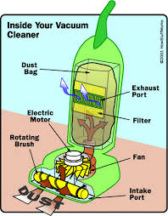
Task Analysis
Introduction to Task Analysis
Task
This is an activity that has to be performed to achieve a goal.
Task analysis
It is the process of analyzing the way people perform tasks.
Task analysis refers to techniques that analyze:
  what people do
  what things they work with
  what they must know
For example: in order to clean the house,
One needs to do the following:
  get the vacuum cleaner out
  fix the appropriate attachments
  clean the rooms
  when the dust bag gets full, empty it
  put the vacuum cleaner and tools away
One works with things such as: vacuum cleaner, the attachments, dust bags, etc
One must know about: vacuum cleaners, their attachments, dust bags, rooms, etc
Notes:
Introduction

Slide 4
Task Analysis
General Method for Task Analysis
The general method for task analysis entails:
  observing the user’s behaviour
  collecting unstructured lists of words and actions
  organizing using notation or diagrams
Note that in task analysis, one should focus on
the user’s objective observable behaviour (external actions)
and not on
the user’s internal mental model
Notes:
Introduction

Slide 5
Task Analysis
Differences from Other Techniques
Task analysis vs. Systems analysis
the user - focus - system design
Task analysis vs. Cognitive modeling
external actions - focus - internal mental state
Notes:
Introduction

Slide 6
Task Analysis
Approaches to Task Analysis
1. Task decomposition
  Splitting task into (ordered) subtasks
2. Knowledge based techniques
  What the user knows about the task and how it is organized
  The focus is on objects and actions
  Taxonomies are created to represent levels of abstraction
3. Entity/object based analysis
  [Describe this]
Notes:
Introduction

Slide 7
Task Analysis
Task Decomposition
Aims
Describe the actions people do
Structure them within task subtask hierarchy
Describe order and/or plans of subtasks
There are several variants:
Hierarchical Task Analysis (HTA): the most common
ConcurTaskTrees (CTT), by Fabio Paternò (Pisa): uses temporal operators
Notes:
Introduction

Slide 8
Task Analysis – Task Decomposition
Hierarchical Task Analysis
Hierarchical Task Analysis (HTA)
It is a task decomposition technique
It has Hierarchy + Plans
  Hierarchy - hierarchy of tasks and subtasks
  Plans - the order of subtasks and the conditions under which they are performed (note that only the plans denote the order)
(see next two slides for illustration)
Notes:
Introduction

Slide 9
Task Analysis – Task Decomposition
Textual HTA
Hierarchy
0. in order to clean the house
1. get the vacuum cleaner out
2. get the appropriate attachment
3. clean the rooms
3.1. clean the hall
3.2. clean the living rooms
3.3. clean the bedrooms
4. empty the dust bag
5. put vacuum cleaner and attachments away
Plans
Plan 0: do 1 - 2 - 3 - 5 in that order. when the dust bag gets full do 4
Plan 3: do any of 3.1, 3.2 or 3.3 in any order depending
on which rooms need cleaning
Notes:
Introduction

Slide 10
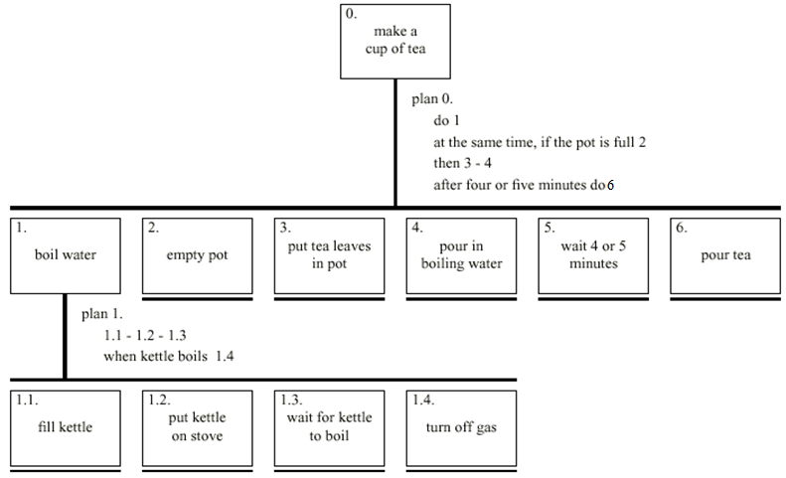
Task Analysis – Task Decomposition
Diagrammatic HTA
Notes:
Introduction

Slide 11
Task Analysis – Task Decomposition
Refining Preliminary HTA
Some heuristics for checking/improving an initial HTA
Paired actions e.g., there is turn off but where is `turn on gas‘?
Restructure e.g., maybe too many tasks at the high level => generate task `make pot‘ to encompass say 3, 4, 5; maybe task 6 should have subtasks
Balance e.g., are tasks on a particular of the same level of simplicity or abstraction, for instance is `pour tea' simpler than `make pot‘?
Generalize e.g., make one cup … or more
Notes:
Introduction

Slide 12
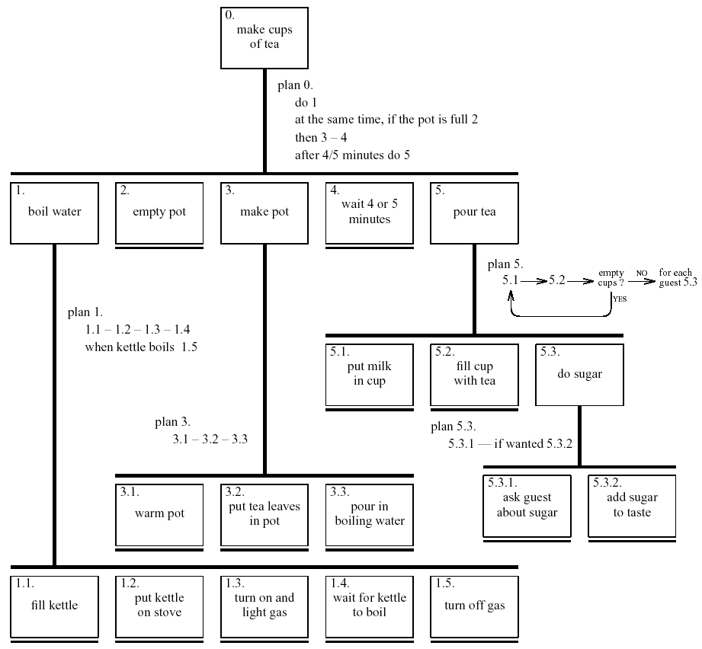
Task Analysis – Task Decomposition
Refined HTA
Notes:
Introduction

Slide 13
Task Analysis – Task Decomposition
Types of Plans
fixed sequence - 1.1 then 1.2 then 1.3
optional tasks - if the pot is full 2
wait for events - when kettle boils 1.4
cycles - do 5.1 5.2 while there are still empty cups
time-sharing - do 1; at the same time …
discretionary - do any of 3.1, 3.2 or 3.3 in any order
mixtures - most plans involve several of the above
Notes:
Introduction

Slide 14
Task Analysis
Knowledge-based Techniques
These techniques or analyses seek to describe/represent what the user knows about the task and how it is organized
The focus is on:
  objects - which are used during the task
  actions - which are performed
The techniques use taxonomies
Taxonomies are created to represent levels of abstraction
Notes:
Introduction

Slide 15
Task Analysis – Knowledge-based Techniques
Knowledge-based Examples
Example – Car control taxonomy
motor controls
steering steering wheel, indicators
cruising ignition, accelerator, clutch, gear stick
lighting
external headlights, hazard lights
internal courtesy light
washing/wiping
wipers front wipers, rear wipers
washers front washers, rear washers
heating temperature control, air direction, fan, rear screen heater
parking hand brake, door lock
Example – Kitchen taxonomy
kitchen items
preparation bowl, plate, chopping board
cooking frying pan, casserole, saucepan
dining plate, soup bowl, casserole, glass
Notes:
Introduction

Slide 16
Task Analysis
Purpose of Task Analysis
Requirement capture and system design
  lift focus from system to use
  suggest candidates for automation
  facilitate presentation and discussion in an interdisciplinary team
  improve understanding of the application domain
  uncover user’s conceptual model
User interface design
  taxonomies suggest menu layout
  object/action lists suggest user interface objects
  task frequency guides default choices
  task sequences guide dialogue design
Supporting evaluation of the system
Documentation and training/teaching
Notes:
Introduction

Slide 17
Task Models
Questions
+
Thanks
Notes:
Opening Slide

